Slide 1

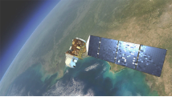
Build with AI Training 2026
Hosted By MMDT
Smart Spatial Analysis Agent
Autonomous Environmental Monitoring using Google ADK, Gemini 2.5 Flash, and Google Earth Engine (GEE)
Group-9 : Thet Htoo Htoo San, Ye Htet Hein Thurein Myo Aung Wint Wah Ko Yin Mon, Shwe Witt Yee, Tin Myo Thu

Slide 2
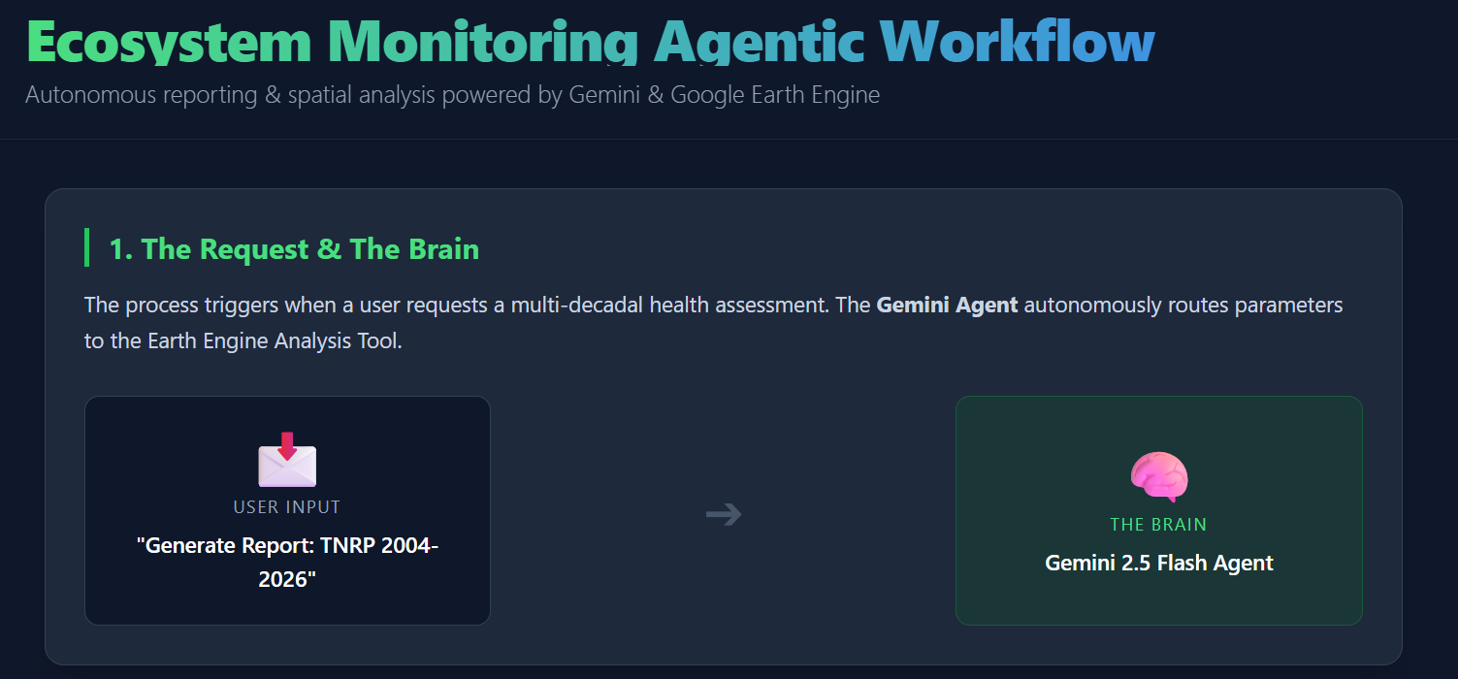

Slide 3
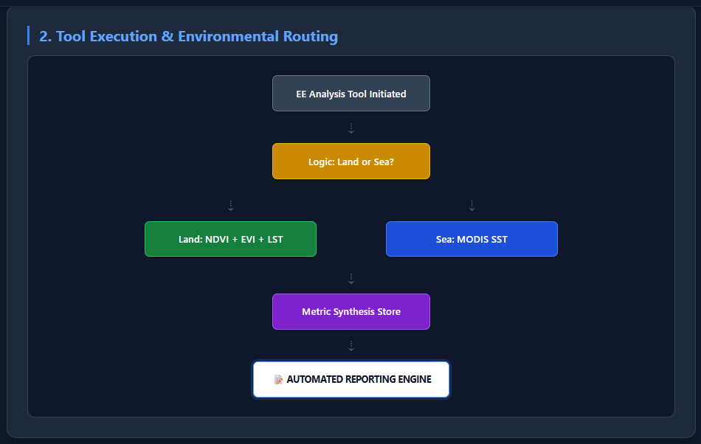
Agent Architecture & Workflow
Intelligent GEE Tooling
The Google ADK Runner orchestrates requests
between the user and the Gemini model. The model identifies spatial intent and triggers the custom Python tool wrapping Earth Engine API calls.
Multimodal reasoning for map interpretation.
Automated sensor selection (L5, L7, L8).
Direct export to CSV or Image artifacts.

Slide 4
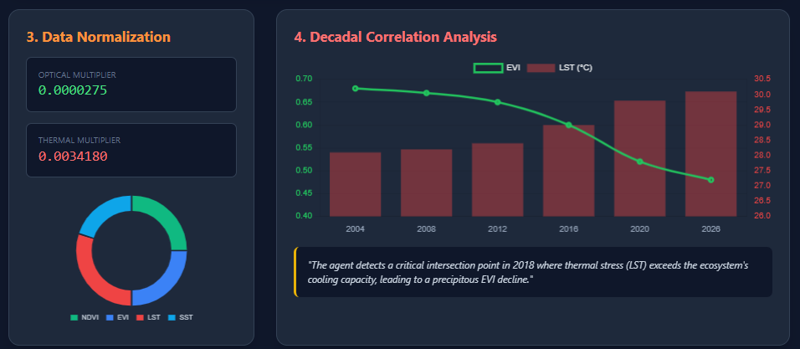

Slide 5
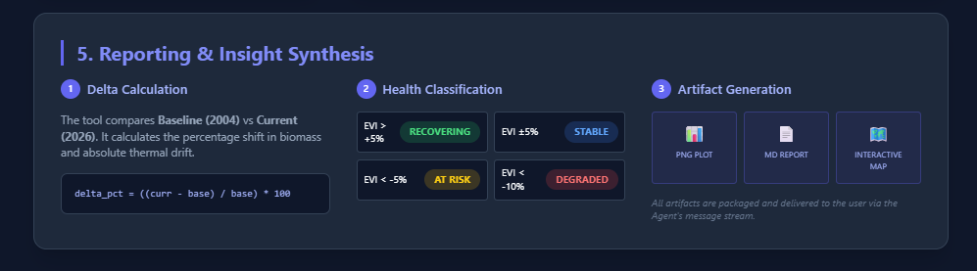

Slide 6

Question and Feedback
Thank You

